Slide 1
Literature reviews
for sociology senior theses
Charlotte Lloyd, Harvard Sociology Department Writing Fellow, 2017-2018

Slide 2
agenda
comprehensive overview
ten practical tips

Slide 3
overview
what is a literature review?

Slide 4
purposes of a literature review
orient your reader by defining key concepts (theoretical) and/or providing relevant background (empirical)
“motivate” your research, i.e. demonstrating the relevance of your project
contribute effectively to science, a collective knowledge-building enterprise
perform symbolic and strategic “solidarity” with others in the field

Slide 5
writing a targeted literature review
a targeted literature review is NOT:
a sophisticated evaluation of the entire literature or literatures related to your topic
a set of thinly connected summaries of important related works haphazardly selected from many subfields
a targeted literature review IS:
a carefully curated set of sources from a small number of subfield literatures
a narrative of where your project comes from and how it fits in with existing knowledge
an argument for why your project makes a valuable contribution

Slide 6
pragmatism: what’s required for my thesis?
“identify 2-3 theoretical arguments or empirical bodies of work in which to situate your research question”
“build a story about what has been done and what needs to be done”
“the culmination of the literature review should be a discussion of how your thesis fits into past research”
10-20 pages
“A Guide to Writing a Senior Thesis in Sociology.” 2015. Department of Sociology, Harvard University. p.18-20, 42-43.

Slide 7
1. explain key terms & concepts
examine your research questions: do they contain any terms that need to be explained? (e.g. identity, discourse, culture, ideology, gender, narrative, collective memory)
be aware that key definitions and background should be provided in the introduction to orient your reader to the topic. the literature review is the place to provide more extended discussions, such as terms that emerge from complicated theoretical traditions

Slide 8
2. motivate your research
in addition to providing useful information about your topic, your literature review must tell a story about how your project relates to existing literature. popular literature review narratives include:
plugging a gap / filling a hole within an incomplete literature
building a bridge between two “siloed” literatures, putting literatures ”in conversation”
solving a puzzle when the literature contradicts itself

Slide 9
When to write the literature review
you should absolutely begin the literature review as one of your first chapters
  start with key terms and empirical background
  make sure you can identify the 2-3 subfields most relevant to your project
for those doing deeply inductive work, you may need to refine your literature review’s narrative after you complete your findings
  if you aren’t sure what your findings are, it will be hard to know exactly how you’re contributing to the literature
  don’t use this as an excuse to procrastinate on becoming familiar with your subfields and writing a partial draft!
literature reviews are slippery, iterative, and constantly evolving projects.
  expect that you will need to revisit your literature review

Slide 10
evaluating individual sources: Start with sympathy
"In studying a philosopher, the right attitude is neither reverence nor contempt, but first a kind of hypothetical sympathy, until it is possible to know what it feels like to believe in his theories, and only then a revival of the critical attitude, which should resemble, as far as possible, the state of mind of a person abandoning opinions which he has hitherto held. Contempt interferes with the first part of this process, and reverence with the second.”
—Betrand Russell, The History of Western Philosophy
Sympathetic Questions:
what is the author’s intent or goal for writing?
what kind of article is the author writing?
  be aware of genre (e.g. lit. review, theory, empirical)
  be aware of field (e.g. sociology, health science).
what knowledge does this article impart?

Slide 11
evaluating individual sources: critique
Critical (critique-able) Questions:
Does the author achieve their stated goal?
  flawed vs. successful articles
How far does this author’s argument/finding carry?
  limitations of research, scope conditions
How does this research fit in the collective enterprise of knowledge?
  misunderstandings, elisions, opacities
  possible future directions, extensions

Slide 12
ten practical tips

Slide 13
literature re
≠
literature
review
“state of
the field”

Slide 14

Host a metaphorical dinner party:
Invite a select number of guests to contribute to an exclusive conversation moderated by you!
Kamler, Barbara. and Pat Thomson. 2006. Helping Doctoral Students Write: Pedagogies for Supervision. London; New York: Routledge. p.37-38

Slide 15
USE the literature as building blocks
“I am always collecting prefabricated parts for use in future arguments. Much of my reading is governed by a search for such modules. Sometimes I know I need a particular theoretical part and even have a good idea about where to find it… […]. I also collect modules I have no present use for, when my intuition tells me I will eventually find the use.”
  “Is working that way plagiarizing or being unoriginal? I don’t think so, although fear of such labels pushes people to think of new concepts. If I need the idea for the table I’m building, I’ll take it. It’s still my table, even though some parts were prefabricated.”
Becker, Howard Saul. 1986. Writing for Social Scientists : How to Start and Finish Your Thesis, Book, or Article. Chicago: University of Chicago Press. p.144-45

Slide 16
hold on to your ideas
“Paying too much attention to [the literature] can deform the argument you want to make. […] If you take the old way too seriously, you can deform the argument you want to make, bend it out of shape in order to make it fit into the dominant approach.”
Becker, Howard Saul. 1986. Writing for Social Scientists : How to Start and Finish Your Thesis, Book, or Article. Chicago: University of Chicago Press. p.147

Slide 17

Be in charge!
You’re using the literature. Don’t let it use you.

Slide 18
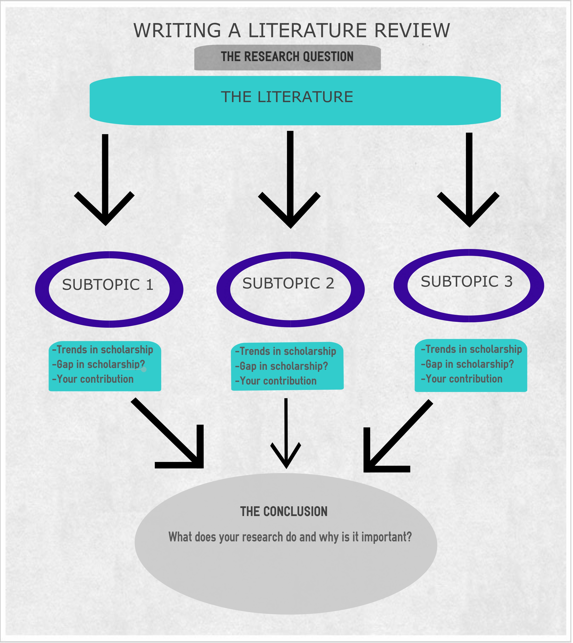
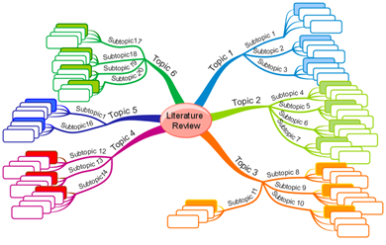
❌
vs.
✅
http://writing.ucdavis.edu/upcoming-events/writing-literature-review & https://srpripas.com/

Slide 19
Don’t be afraid to leave out a source…
… if it’s that important, your advisor will tell you.

Slide 20
remember the collective enterprise
”It’s alright to aim for the stars, but we ought to have a decent regard for what is humanly possible. If making a scientific or scholarly revolution singlehandedly is our chief gal, we are bound to fail. Better to pursue the goals of normal science: to do a piece of good work others can use, and thus increase knowledge and understanding.”
Becker, Howard Saul. 1986. Writing for Social Scientists : How to Start and Finish Your Thesis, Book, or Article. Chicago: University of Chicago Press. p.140

Slide 21
Qual folks—remember that your work is always unique!

Slide 22
literature reviews are identity work
“[T]here is a lack of recognition of the intensity of identity work involved at this site of text production. We would go so far as to say that literature reviews are the quintessential site of identity work.”
The literature review is an opportunity to discover and craft your scholarly identity through the kinds of questions you engage, the discussions you enter, the critiques you launch, and the research you advance. So be authentic!
Kamler, Barbara. and Pat Thomson. 2006. Helping Doctoral Students Write: Pedagogies for Supervision. London; New York: Routledge. p.29

Slide 23
Questions?
Charlotte Lloyd, Harvard Sociology Department Writing Fellow, 2017-2018
charlottelloyd@fas.harvard.edu
https://projects.iq.harvard.edu/sociologydwf/departmental-writing-fellow

Slide 24
Bibliography
“A Guide to Writing a Senior Thesis in Sociology.” 2015. Department of Sociology, Harvard University.
Becker, Howard Saul. 1986. Writing for Social Scientists : How to Start and Finish Your Thesis, Book, or Article. Chicago: University of Chicago Press. [Chapter 8: “Terrorized by the Literature”]
Kamler, Barbara. and Pat Thomson. 2006. Helping Doctoral Students Write: Pedagogies for Supervision. London; New York: Routledge. [Chapter 3: “Persuading an octopus into a glass: Working with literature”]

